Slide 1
China-Russia Arctic Cooperation on the Traditional Medicine
GUO Peiqing peiqignguo@163.com
Ocean University of China
24 Nov. 2022

Slide 2
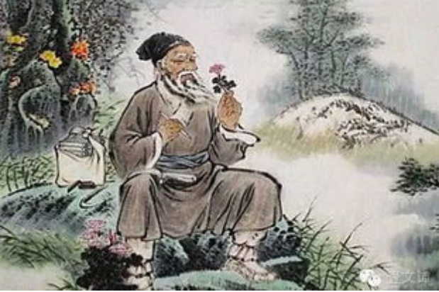
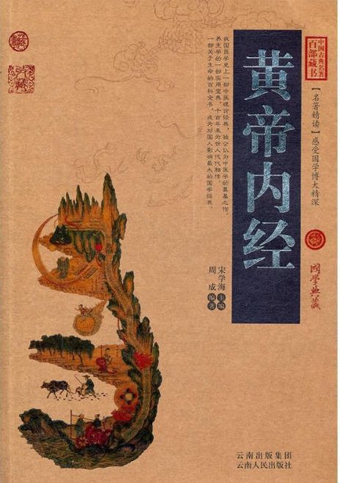
Traditional medicine has much advantages in the human being history, popularly used in the ancient era.
Unfortunately, these advantages is flooded by modern medicine, which may be called as chemical medicine.
Which country has developed very well traditional medicine? China!
Before 4400 years

Slide 3
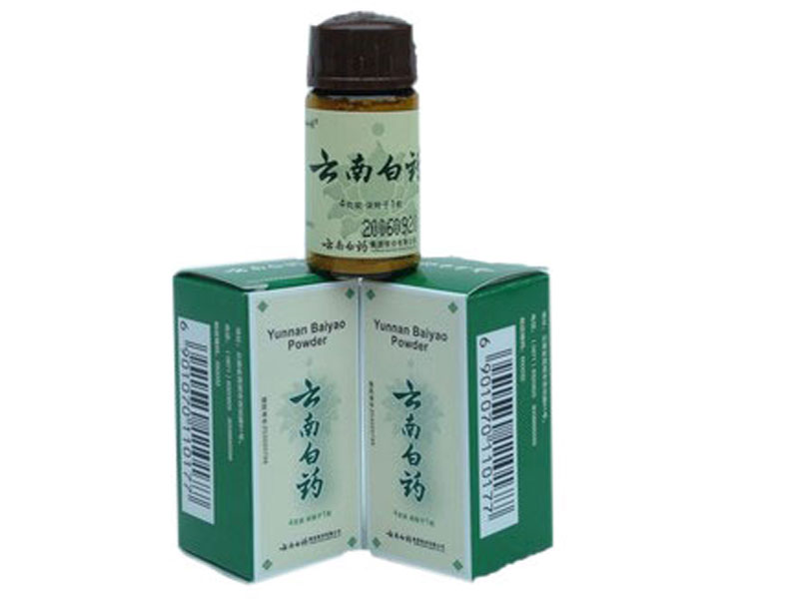
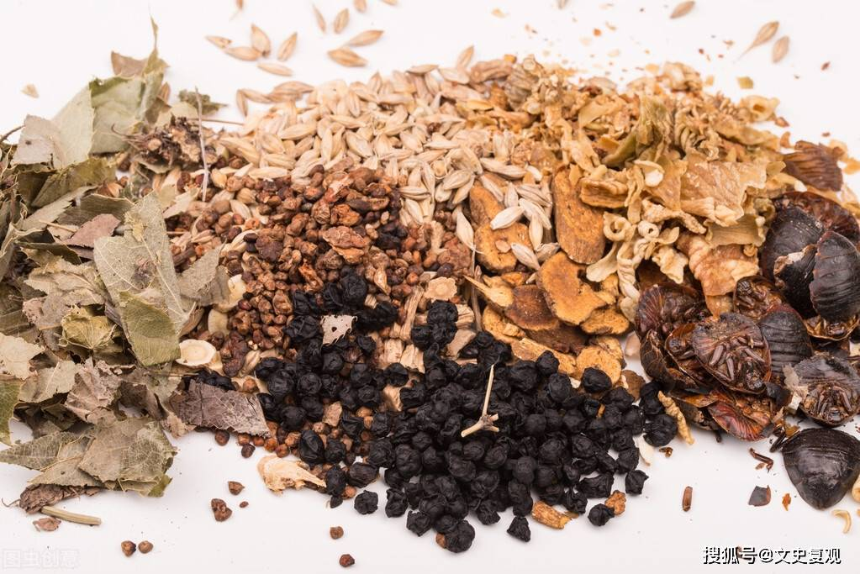
Yun-nan Baiyao Powder is one representative of Chinese medicines.
It can heal the wound/injury in soft issue than any other medicine including antibiotic!
Don’t believe it? Try it by yourself.
part raw materials of
Yun-nan Baiyao

Slide 4
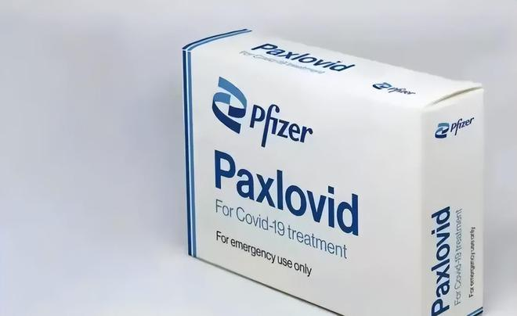
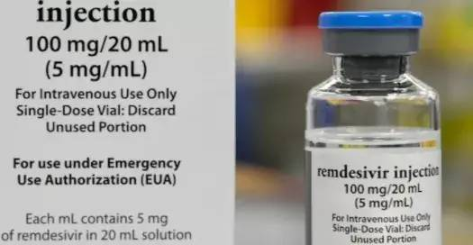
Chinese traditional medicine played an important role in the harsh time of Covid-19.
The fatality rate and severe illness rate of coronavirus in China is the MOST LOWEST in the world. Traditional medicine has contributed much!
What result of Comparison between chemical medicine and Chinese traditional medicine?
Patients have a big say!

Slide 5
There is much herb and medicine waiting for being found and researched in Russian Arctic.
Arctic plant and microorganism grown in high north should be different from middle or low latitude.
I hope China and Russia medical experts can work together to investigate these plants in Arctic and had joint-research.
It is recognized comprehensively in China that Arctic medicine has a wide market prospect.
Shandong province is famous for traditional medicine knowledge and skill, and Provincial Government has established wonderful policy to support traditional medicine oversea.
It is high time to network medical experts of both sides.

Slide 6
Thanks!
Contact: peiqingguo@163.com
Скажите мне, если у вас есть хорошие предложения!

