Slide 1
EMRAD East Midlands Imaging Network
Jacqueline Moxon
EMRAD Senior Project Manager
30th March 2021

Slide 2
Establishing a Network
Mandate
Governance
Return on Investment
Agreements
Stakeholders
Strategic vision

Slide 3
Governance
Cultural Shift

Slide 4
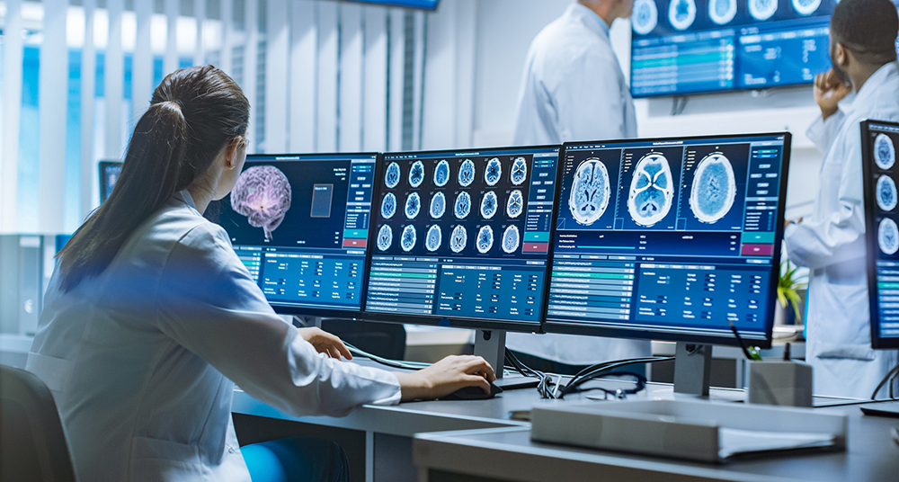
EMRAD Strategy
PAC Procurement
Artificial Intelligence - The reality
Breast Screening
Operational AI/
MSK - Knee
Lung
Cardiology

Slide 5
The heart of the engine
Small teams can make a big change to patient care
Evolving in a complex healthcare system
Strong Communication & Process Channels
Opportunities

Slide 6
Collaboration
Build trust through transparency
www.emrad.nhs.uk
@emradNHS

Slide 7
The Importance of Patient Involvement
Introducing Michael Prior

