Slide 1

Cardiology Digital Environment
Insights from London
Dr Ameet Bakhai, MBBS, MD, FRCP, FESC
Cardiologist / Research Director / Clinical Lead / Innovator
Royal Free London NHS Trust / Barnet CCG / Amore Health Ltd
asbakhai@nhs.net

Slide 2
Disclosures - Advisor / Lecturer / Appraiser / Founder
NHS (Employee)
NICE
Surrey Heath CCG Board
Abbott
ABPI
Accentus Medical
Amgen
Amore Health Ltd
Astra Zeneca
Bayer
Boehringer Ingelheim
BMS
Closer Still Media
Daiichi Sankyo
FPM
Health Smart
Janssen
Lattice Point
Medtronic
McKinsey
MSD
Napp
Novartis
Novo Nordisk
Oxford Outcomes
Pfizer
Remedica
Sanofi Aventis
Tickerfit
TrusteDoctor
UCL

Slide 3
Medicine
Patient
Knowledge
Clinician
Intervention

Slide 4
Illness
Disease
Body
Organ
Family unit
Quality of life
Expectations
Medicine
Patient
Knowledge
Clinicians
Intervention
Physical & Virtual
Experience
Training
Awareness
Surfing
Simulation
Connected

Slide 5
Wider
Counselling
Employer
Society DVLA, Aviation Travel
Insurance
QoL measures:
World Health Organisation Quality of Life WHO-QoL / European QoL
Short Form – 12 / 36
Hospital Anxiety and Depression Scale
KCCQ
Illness
Disease
Body
Organ
Family unit
Quality of life
Expectations
Medicine
Patient
Knowledge
Clinicians
Intervention
Physical & Virtual

Slide 6
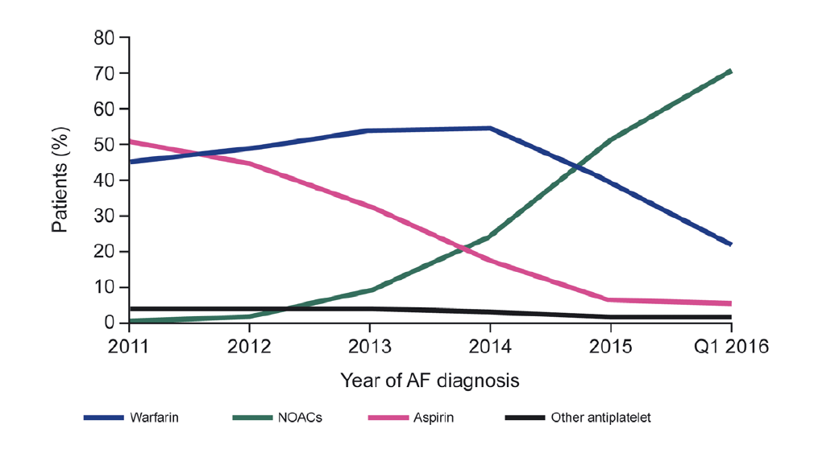
Current treatment patterns from the UK Clinical Practice Research Datalink (CPRD) – 42,966 patients first AF between 2011 and 2016¹
Overall, 9143 patients (21.3%) remained without AF treatment post-index diagnosis¹
Proportioned prescribed NOACs increased from 2.0% to 70.1%¹
From 2015 Warfarin was no longer the dominant OAC
Proportion of patients receiving aspirin for >3 months post-index declined during the study from 50.6% to 5.5%¹
Continuous treatment after first AF diagnosis, by
prescription type and year of diagnosis¹
n = 7286; patients who initiated treatment within 3 months after AF index and remained on treatment for ≥3 months. AF: atrial fibrillation; NOAC: novel oral anticoagulant
1. Bakhai A et al. J Eval Clin Pract. 2020;1–15.

Slide 7
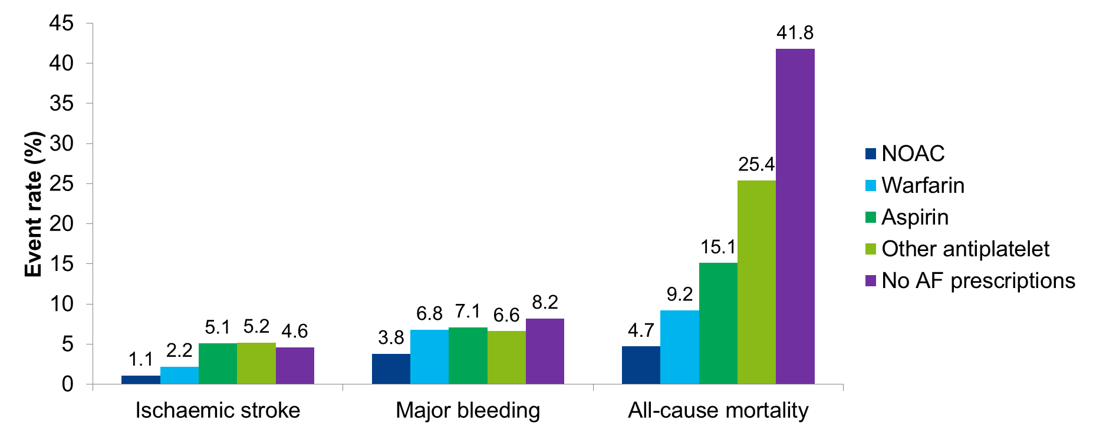
Sex- and age-adjusted incidence rate of ischaemic stroke and major bleeding events: Data from a UK clinical practice research primary care database¹
NVAF patients remained on the same initial treatment for 3 consecutive months. AF: atrial fibrillation; NOAC: novel oral anticoagulant.
1. Bakhai A et al. J Eval Clin Pract. 2020;1–15.

Slide 8
Medicine
Patient
Knowledge
Clinicians
Intervention
Social datasets
Predictors *
Machine learning *
Patterns
Audits
Research
Physical & Virtual
Guidelines
Best practice
Data
Publications
Conferences
Internet
PubMed / Google Scholar

Slide 9
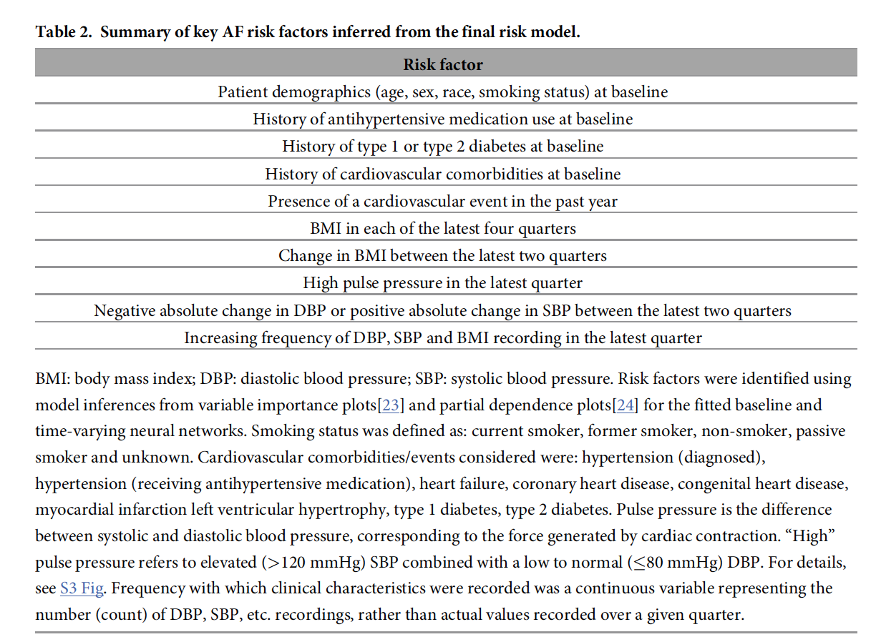
A look to the future – Predicting atrial fibrillation using machine learning
1. Hill NR, et al. (2019) Predicting atrial fibrillation in primary care using machine learning. PLoS ONE 14(11): e0224582.

Slide 10
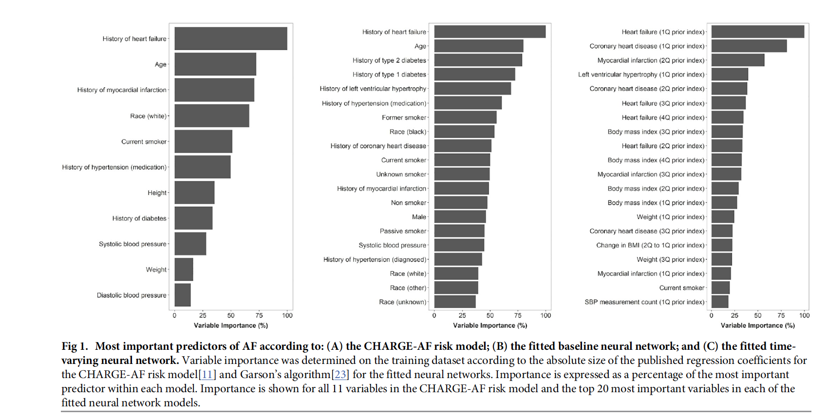
A look to the future – Predicting atrial fibrillation using machine learning
1. Hill NR, et al. (2019) Predicting atrial fibrillation in primary care using machine learning. PLoS ONE 14(11): e0224582.

Slide 11
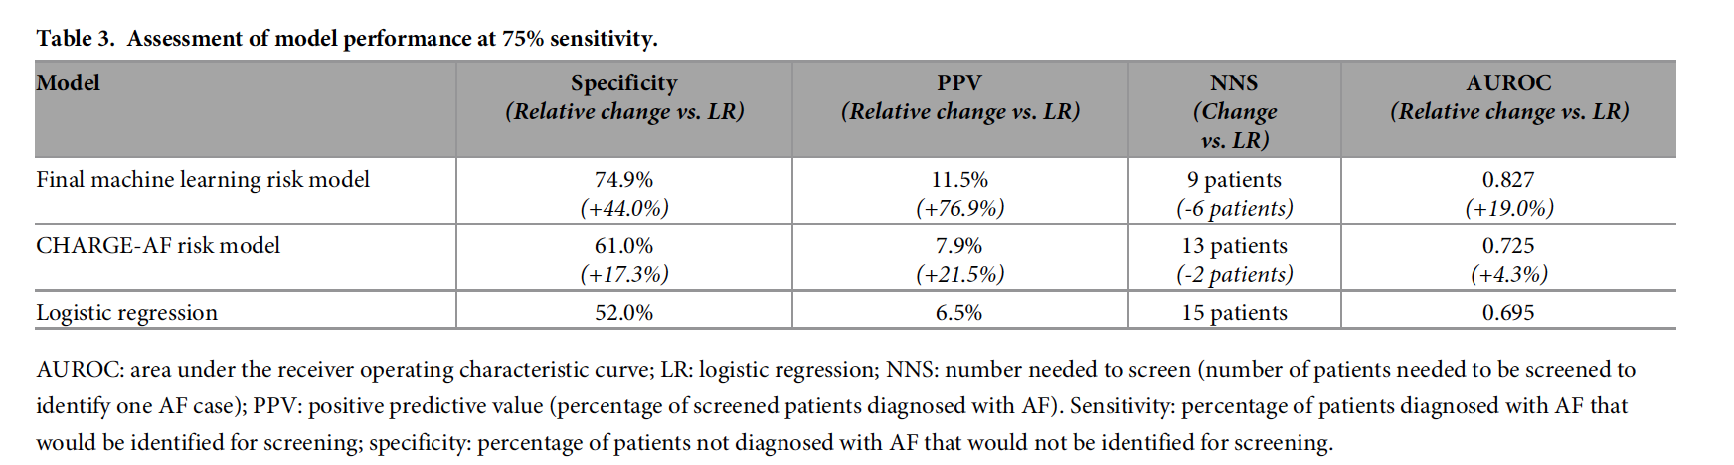
A look to the future – Predicting atrial fibrillation using machine learning
1. Hill NR, et al. (2019) Predicting atrial fibrillation in primary care using machine learning. PLoS ONE 14(11): e0224582.

Slide 12
Scores
Major Adverse Cardiac Outcomes:
Deaths, Strokes, Heart Attacks
Length of stay
Readmission rates
Adverse Event Rates
Concordance
Patient Adherence
Medicine
Patient
Knowledge
Clinicians
Intervention
Social datasets
Predictors *
Machine learning *
Patterns
Physical & Virtual
Tests
Bedside – Alivecor Kardia
Bloods – NT-proBNP
Imaging – AI Amyloid
Invasive
Data
Publications
Conferences
Internet
PubMed
Google Scholar
Bloods
Biomarkers – NT-proBNP, HbA1c
UK Biobank
Immune markers, Variants

Slide 13
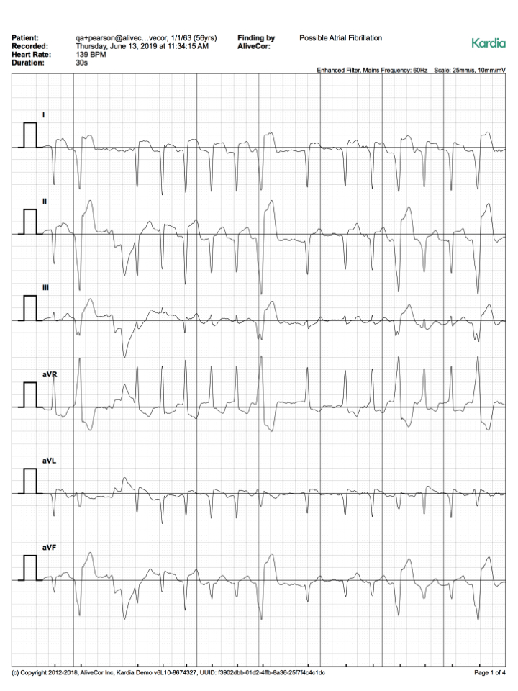

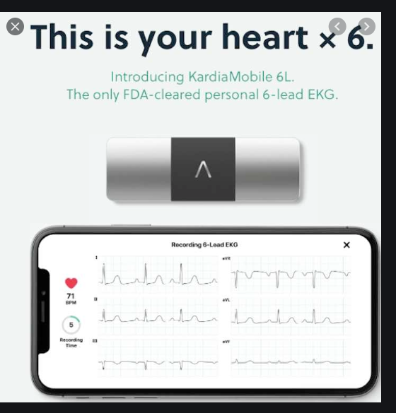
Alivecor
Kardia 6L

Slide 14
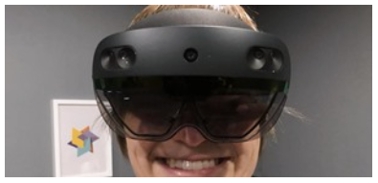
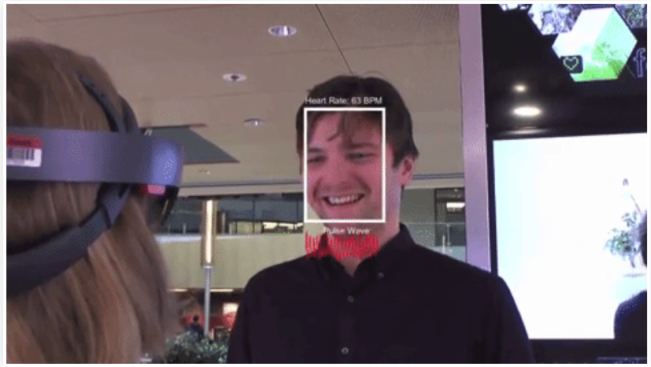
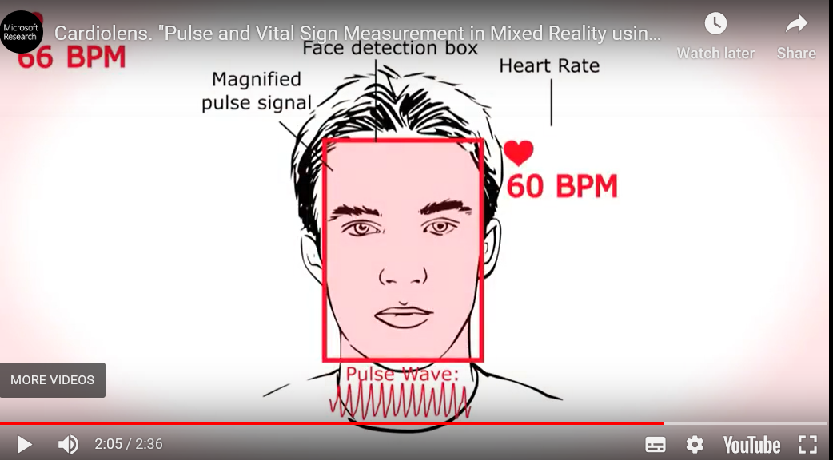
Microsoft Hololens: augmented reality pulse monitoring
“Imagine if you could see a person’s pulse just by looking at them”

Slide 15
Economic incentives
Peer support
Avatar / Chatbot / Virtual Monitors
Digital
Vaccines
RNA technologies - Inclisiran
Monoclonal antibodies – PSCK9i
Diet & Supplements
Prediction Scores
Medicine
Patient
Knowledge
Clinicians
Intervention
Physical & Virtual
Audits
Research
Lifestyle
Drugs
Devices
Education
Guidelines
Best practice

Slide 16
Medicine
Patient
Knowledge
Clinicians
Intervention
Physical & Virtual
Experience
Training
Awareness
Surfing
Simulation
Connected
Patient Recovery
Rehabilitate Tickerfit
End of life care NCEPOD
Mortality Prediction Scores
Palliative Care at Home
Hospice
Patient focus
Pathway focus – Digital pathways Cerner, EPIC
System focus - Chess / Deepmind
Community focus - Get It Right First Time

Slide 17
Covid 19 Data – In progress & Un-published

Slide 18
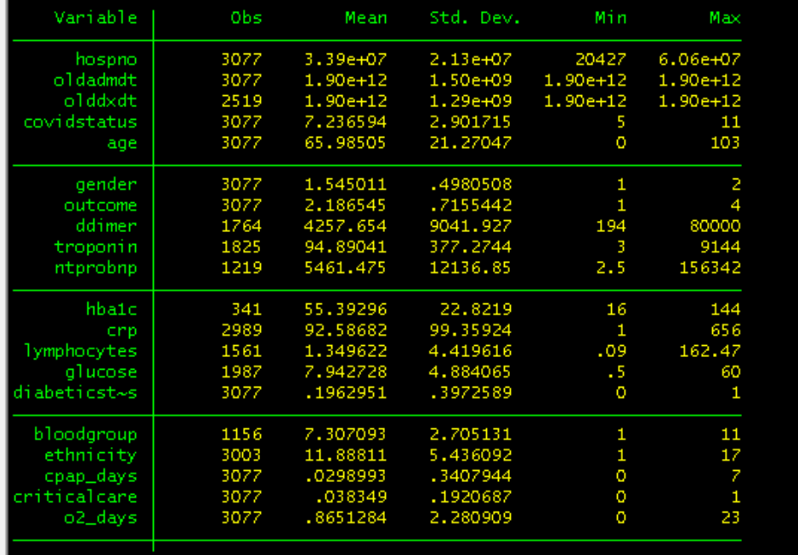

Slide 19
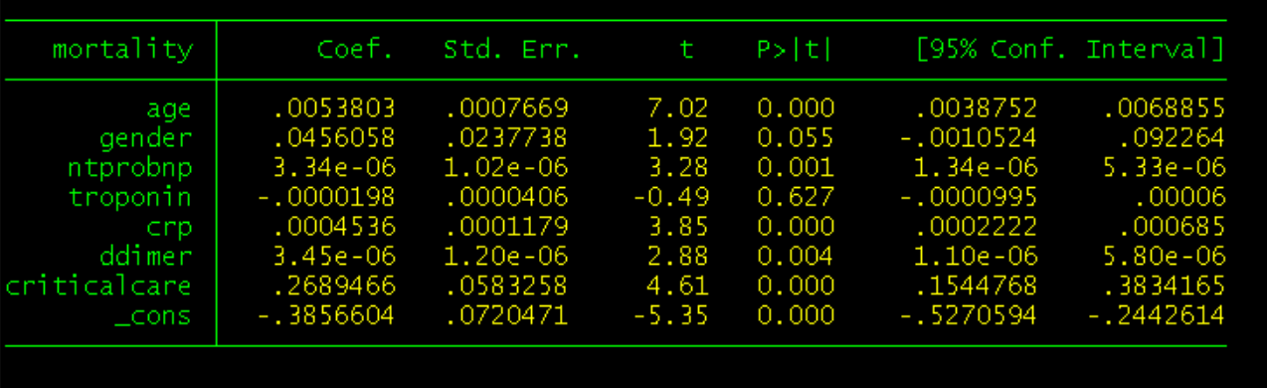
Covid 19 Data
NT proBNP as interesting

Slide 20
Medicine
Patient
Knowledge
Clinicians
Intervention
Physical & Virtual
Experience
Training
Awareness
Surfing
Simulation
Connected
Patient Recovery
Rehabilitate Tickerfit
End of life care NCEPOD
Mortality Prediction Scores
Palliative Care at Home
Hospice
Patient focus
Pathway focus – Digital pathways Cerner, EPIC
System focus - Chess / Deepmind STREAMS
Community focus - Get It Right First Time

Slide 21
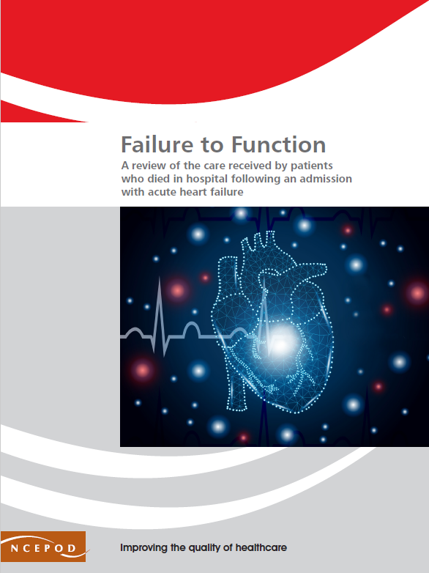
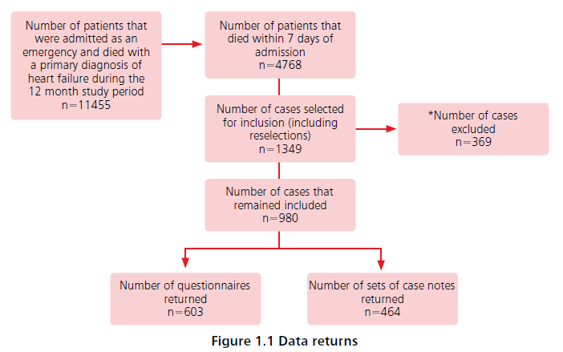
NCEPOD Report on Acute Heart Failure Deaths
Nov 22nd 2018
www.ncepod.org.uk/2018ahf.html

Slide 22
Data Focus
National Audits (NCOR, MINAP)
Patient Reported Outcome Measures (PROMs)
Patient feedback – Clinician Ratings
Device collected Outcomes
Mobile
Wearables
Sensors - Heartfelt
Medicine
Patient
Knowledge
Clinicians
Intervention
Physical & Virtual
Experience
Training
Awareness
Surfing
Simulation
Connected

Slide 23
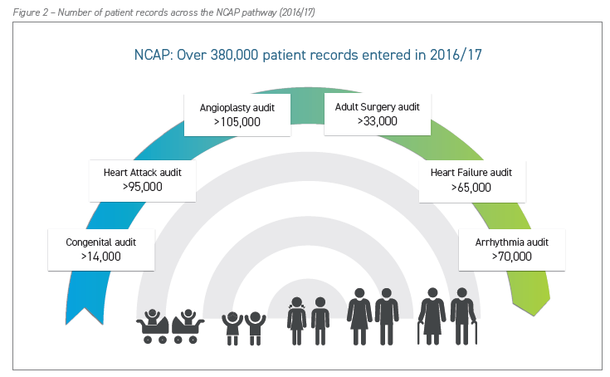
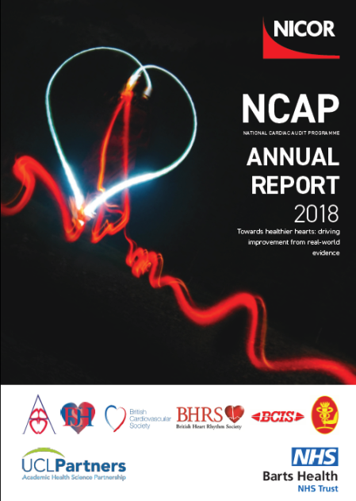

Slide 24
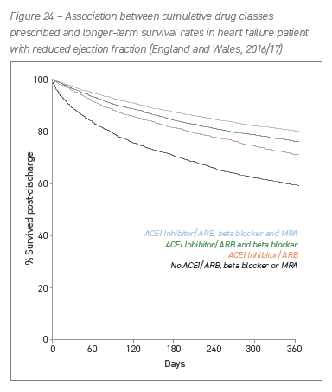
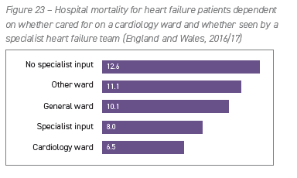

Slide 25
National Health Service
Payor via Taxes
National Institute for Health and Care Excellence
Clinical and Cost effectiveness
National Institute for Health Research (NIHR)
Research & Grants
MHRA
Regulation
Safety
Yellow card
Efficacy
NHS Digital & NHSX
Digital and £50M AI Grants
NHS DigiTrials
- Use data collection for Research
NHS Accelerator Innovation
TrustedDoctor
Tickerfit
NHS Accelerated Access Collaborative
HeartFlow
PCSK9 inhibitors
Inclisiran
High Sensitivity Troponin
Art of Medicine
Patient
Knowledge
Clinician
Intervention

Slide 26
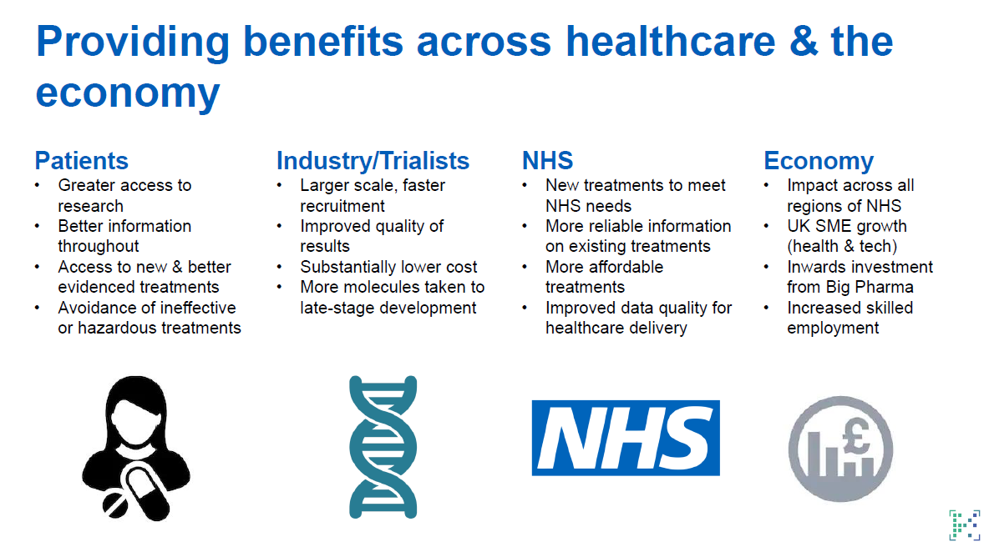
NHS DigiTrials

Slide 27
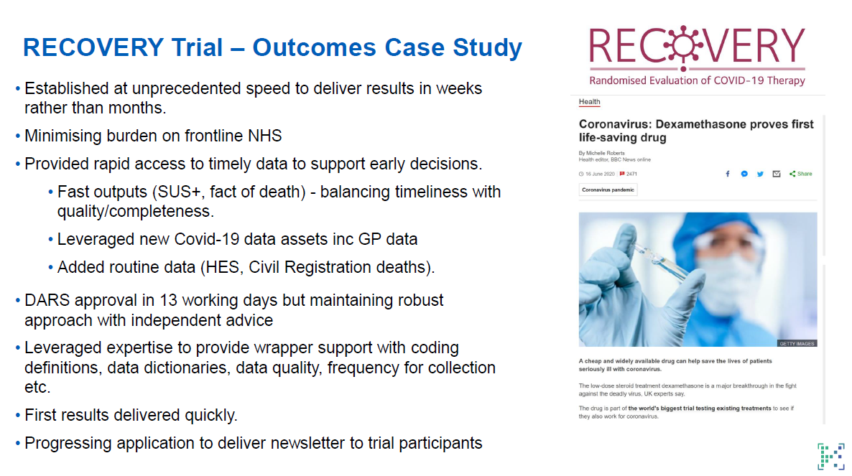
NHS DigiTrials

Slide 28











Sources of Data in AF with DOACs¹⁻¹⁵
RCT
RE-LY⁵
ROCKET-AF¹
ARISTOTLE⁶
AVERROES⁷
ENGAGE-AF⁸
Study | Number of patients enrolled
ENGAGE-AF⁸ | 21,105
RELY⁵ | 18,201
ROCKET-AF¹ | 14,264
ETNA-AF¹⁵ | 13,980
XAPASS⁹ | 11,308
ARISTOTLE⁶ | 7,518
XANTUS² | 6,784
AVERROES⁷ | 5,599
Independent Central Adjudication Committee (CAC)
HIGH QUALITY
PROSPECTIVE
non-interventional
study
XANTUS²
XAPASS⁹
¹⁵
PROSPECTIVE
Registry
³
¹⁰
¹¹
¹²
¹³
¹⁴
RETROSPECTIVE
Databases⁴
Information provided by Professor Raffaele de Caterina
DOAC: Direct oral anticoagulants
1. Patel MR et al, N Engl J Med 2011;365:883–891. 2. Camm AJ et al. Eur Heart J 2016;37:1145-53. 3. Hecker J et al, Thromb Haemost 2016;115:939-49. 4. Coleman CI et al. Int J Cardiol 2016;203:882-4. 5. Granger CB et al. N Eng J Med 2011;365(11)981–992. 6. Hohnloser SH et al. Eur Heart J 2012;33(22):2821-30. 7. Connolly SJ et al. N Engl J Med 2011; 364:806-817. 8. Giugliano RP et al. N Engl J Med 2013;369:2093-2104. 9. Ikeda T et al. J. Cardiology 2019;74:60-66. 10. Mazurek M et al. Europace 2020;22:47–57. 11. Kakkar AK et al. Am Heart J 2012;163:13-19. 12. Kirchhof P et al. Europace 2014;16:6–14. 13. Inohara T et al. Heart 2020;106(5):358-364. 14. Shimokawa H et al. Int J Cardiol 2018;258:126-132. 15. De Caterina R et al. BMC Cardiovasc Disord 2019;19:165

Slide 29
ETNA-AF Europe: Design
Post-authorization safety study (PASS)
13.100 patients
exposure to Edoxaban
10 European countries
non interventional
~ 900 sites
Patients with documented non valvular AF
non selected patients
1 year recruitment
4 yr observation per patient
prospective
Joint safety analysis after 1,5 years with ETNA-VTE-EU
real world evidence

Slide 30
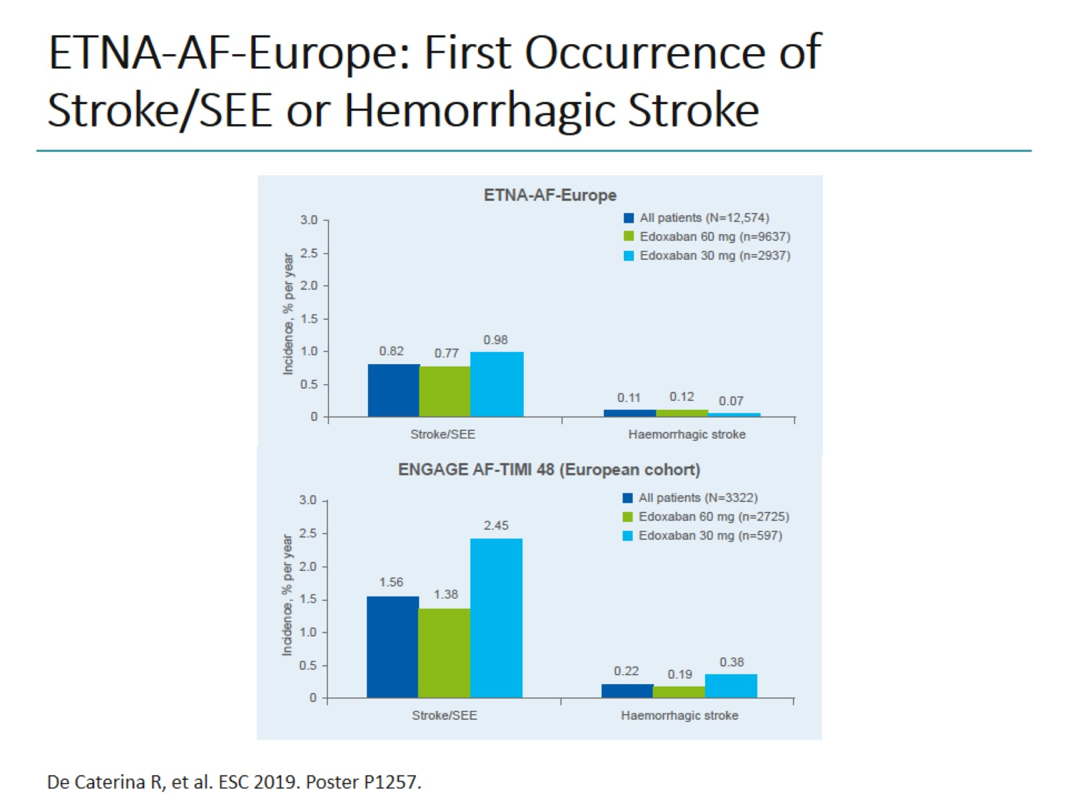
ETNA-AF-Europe: First Occurrence of Stroke/SEE or Hemorrhagic Stroke

Slide 31
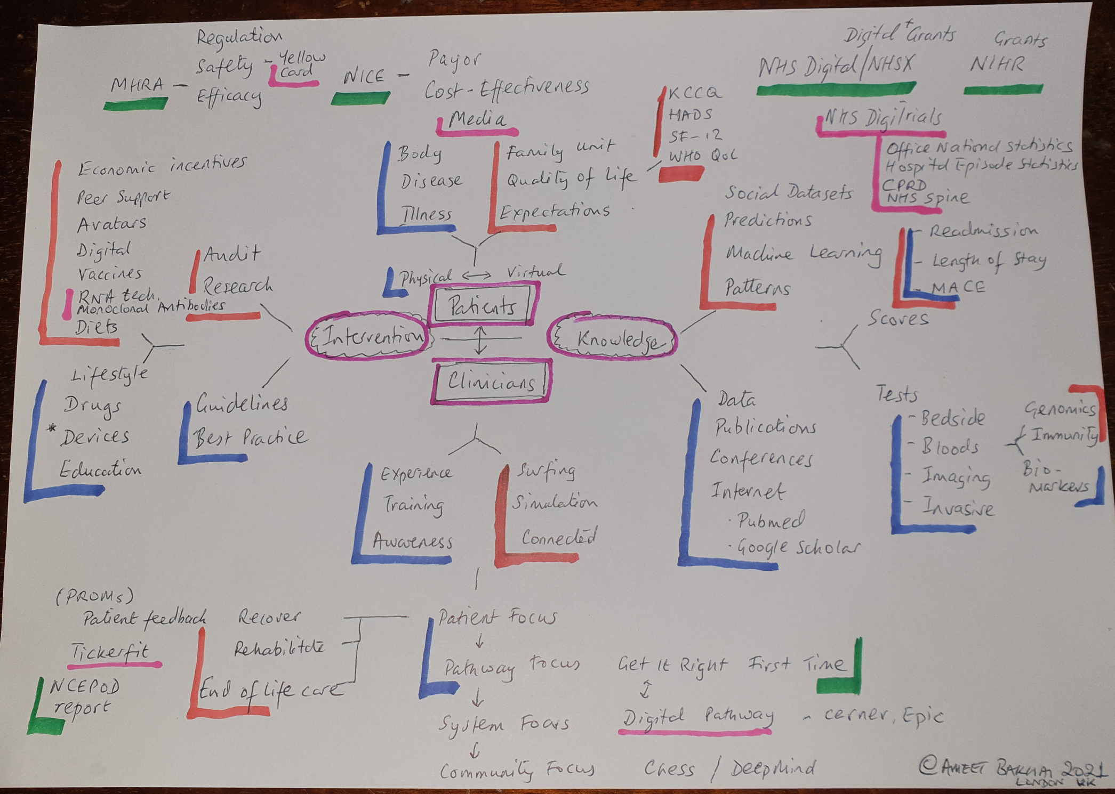

Slide 32
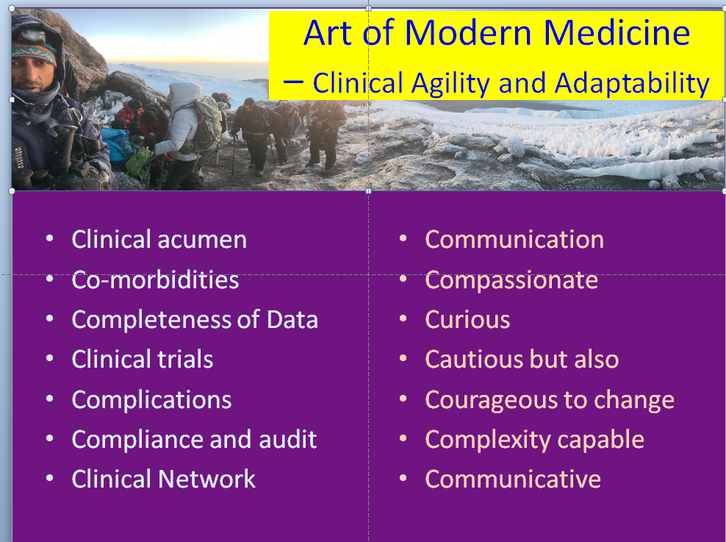

Slide 33
Cardiology Digital Environment
Insights from London
Dr Ameet Bakhai, MBBS, MD, FRCP, FESC
Cardiologist / Research Director / Clinical Lead / Innovator
Royal Free London NHS Trust / Barnet CCG / Amore Health Ltd
asbakhai@nhs.net

Slide 34
Issues – big data – friend or foe?
Big disruption ! Challenging personalised medicine.
Data rich vs Data poor
Data biases – data capture on the young / the healthy
Data holes could drastically change the interpretation
Data access limitation by regulations
Access to data fishing
Completeness of Data
Can we afford Data answers – ‘resourcing prevention‘
How do we grow Data doctors / data analysts / data scientists / data engineers?

